Slide 1
A quick look at WICA: an extra tool in our Control System Toolkit
Simon Rees :: Software Engineer :: GFA Controls Section :: Paul Scherrer Institute
SLS HLA Workshop: Jan 19, 2024

Slide 2
Introduction
At PSI we are mostly using traditional, non-web, technologies
A few of us both here at PSI, and in other science labs, have been working on projects using web technology. The use of any new technology is always a trade-off. There are rarely any magic bullets.
A few years ago, I was asked to work on a project to make the facility status displays available externally on the web, so I got a chance to look at some of those trade-offs.
The result of that work was a software product called WICA which enables us to bring live EPICS control system data from any of our facilities to a user’s web page, on a variety of mobile devices, either at PSI, or off site.
My goal for this workshop is not to spend time debating the merits or otherwise of the web but to get you to try out WICA for yourselves so you can decide whether there are some situations where you might find it useful.

Slide 3
What is WICA ?
WICA stands for Web Interface for Controls Applications
The basic idea is to support the streaming of live EPICS control system data to update a user's web pages in real-time.
There are two main components:
Wica-HTTP - this is a gateway which can stream EPICS channel-access data over the web.
Wica-JS - this is a Javascript library which you include on your web page to get hold of the data and to render it.

Slide 4





WICA Overview Picture
An HTTP/EPICS gateway for streaming live control system data.
Control System
IOC
http (POST, GET)
WICA-HTTP
Server
CA (get, monitor)
IOC
IOC
Web Browser
(desktop, tablet, mobile…)
Web Server
WICA Web Pages
Control system web pages, ideally created by the end-users.
http (GET)
WICA Web Pages
Uses special (data-wica-*) markup attributes:
to identify the control system channels of interest.
to control how it is displayed.
WICA-JS
Users
A Javascript library for updating control system web pages, using data received from the WICA-HTTP server.

Slide 5
The simplest Wica Web Page
<!doctype html> <html lang="en"> <head> <meta charset="utf-8"/> <title>Wica Demo Page</title> <script src="/wica/wica.js" type="module"></script> </head> <body> <h1>Wica Demo Page</h1> <label>Channel-1:</label> <span data-wica-channel-name="SINEG01-MBND300:I-READ"></span> <br> <label>Channel-2:</label> <span data-wica-channel-name="SINLH02-MBND100:I-READ"></span> <br> <label>Channel-3:</label> <span data-wica-channel-name="SINBC02-MBND100:I-READ"></span> <br> </body> </html>
Loads the Wica-JS library
Identify the EPICS channels

Slide 6
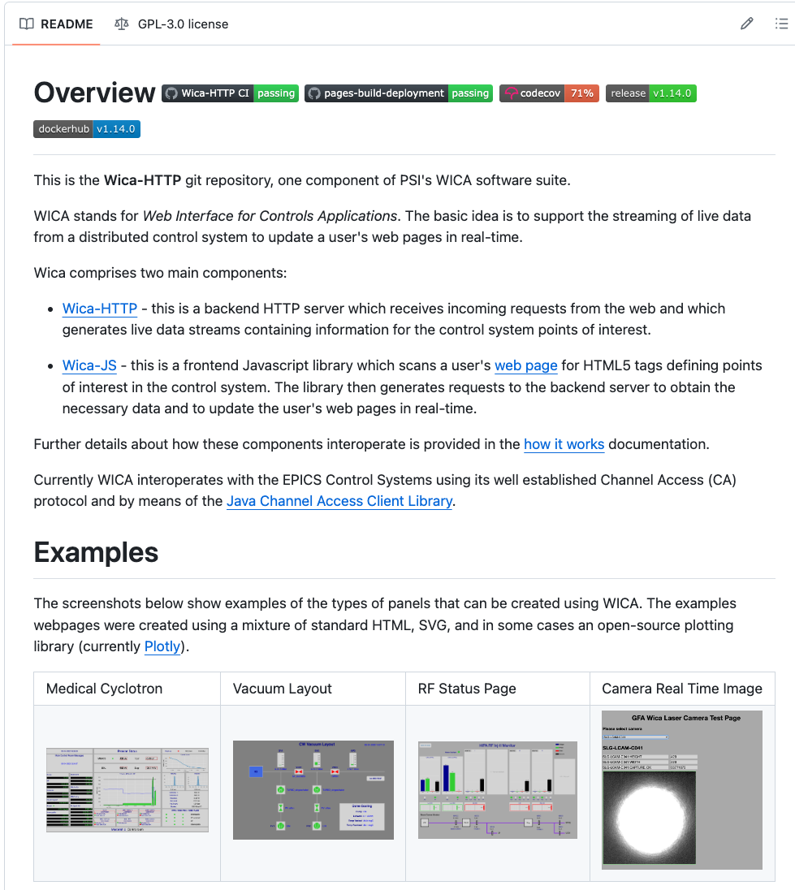
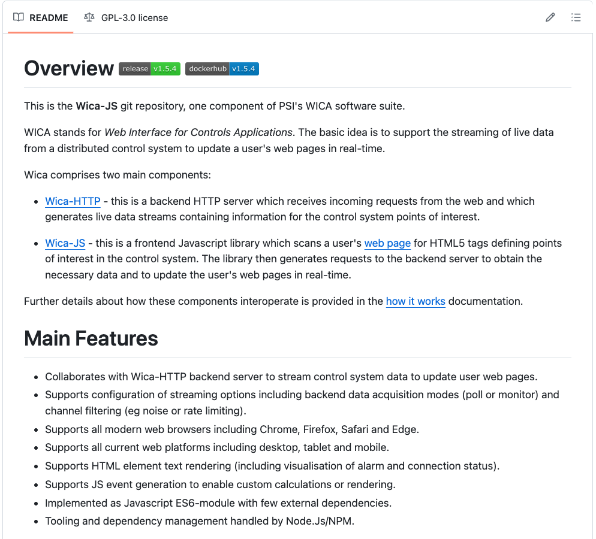
WICA-Http and Wica-JS are on GitHub
https://github.com/paulscherrerinstitute/wica-http
https://github.com/paulscherrerinstitute/wica-js

Slide 7
Workshop Exercises
Let’s make a start…

Slide 8
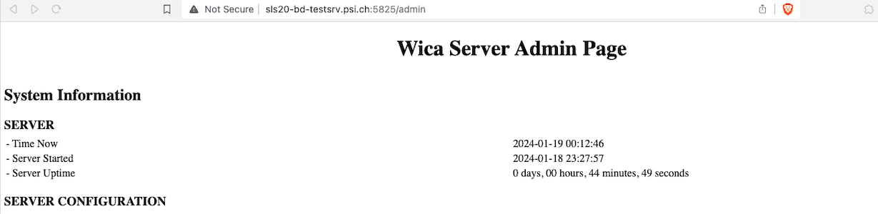
Exercise 1: Download, and run the Wica-HTTP server locally
⏰ 5 mins
Follow the instructions at the following URL to download and run the Wica-Http server in your own user account and unique port on the HLA test machine
https://github.com/paulscherrerinstitute/wica-http/blob/master/docs/hla/ex1.md
The server admin page should look like this:

Slide 9
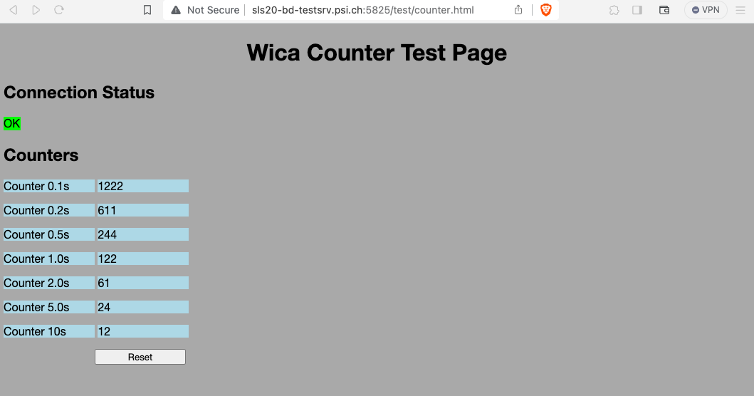
Exercise 2: I will run the EPICS ‘counter.db’ test database on the local machine. See if your local server instance can connect to it.
⏰ 5 mins
Navigate to the following URL, but swap the port number of your local server for the one below
http://sls20-bd-testsrv.psi.ch:5825/test/counter.html

Slide 10
The ‘counter.db’ database looks like this
record( calc, "wica:test:counter01" ) {
field( SCAN,".1 second")
field( CALC,"VAL+1")
}
record( calc, "wica:test:counter02" ) {
field( SCAN,".2 second")
field( CALC,"VAL+1")
}
record( calc, "wica:test:counter03" ) {
field( SCAN,".5 second")
field( CALC,"VAL+1")
}
record( calc, "wica:test:counter04" ) {
field( SCAN,"1 second")
field( CALC,"VAL+1")
}
record( calc, "wica:test:counter05" ) {
field( SCAN,"2 second")
field( CALC,"VAL+1")
}
record( calc, "wica:test:counter06" ) {
field( SCAN,"5 second")
field( CALC,"VAL+1")
}
record( calc, "wica:test:counter07" ) {
field( SCAN,"10 second")
field( CALC,"VAL+1")
}
Provides a series of counter channels running at different rates…

Slide 11
The ‘counter.html’ web page looks like this
<!doctype html>
<html lang="en">
<head>
<meta charset="utf-8"/>
<meta name="viewport" content="width=device-width, initial-scale=1"/>
<title>Wica Test Counter</title>
<!-- Load the Wica library from the local machine -->
<script src="../wica/wica.js" type="module"></script>
<style>
<!-— add CSS styling to web page here -->
</style>
</head>
<body>
<div>
<h2>Counters</h2>
<label>Counter 0.1s </label> <label data-wica-channel-name="wica:test:counter01">NC</label><br>
<label>Counter 0.2s </label> <label data-wica-channel-name="wica:test:counter02">NC</label><br>
<label>Counter 0.5s </label> <label data-wica-channel-name="wica:test:counter03">NC</label><br>
<label>Counter 1.0s </label> <label data-wica-channel-name="wica:test:counter04">NC</label><br>
<label>Counter 2.0s </label> <label data-wica-channel-name="wica:test:counter05">NC</label><br>
<label>Counter 5.0s </label> <label data-wica-channel-name="wica:test:counter06">NC</label><br>
<label>Counter 10s </label> <label data-wica-channel-name="wica:test:counter07">NC</label><br>
<label></label><button onclick="resetCounters()">Reset</button><br>
</div>
<script>
<!-— add JS “intelligence” to your web page here -->
</script>
</body>
</html>
Loads the Wica-JS library
data-wica-channel-name Defines the EPICS channels you want to display
Content gets rendered ‘automagically’ in real-time

Slide 12
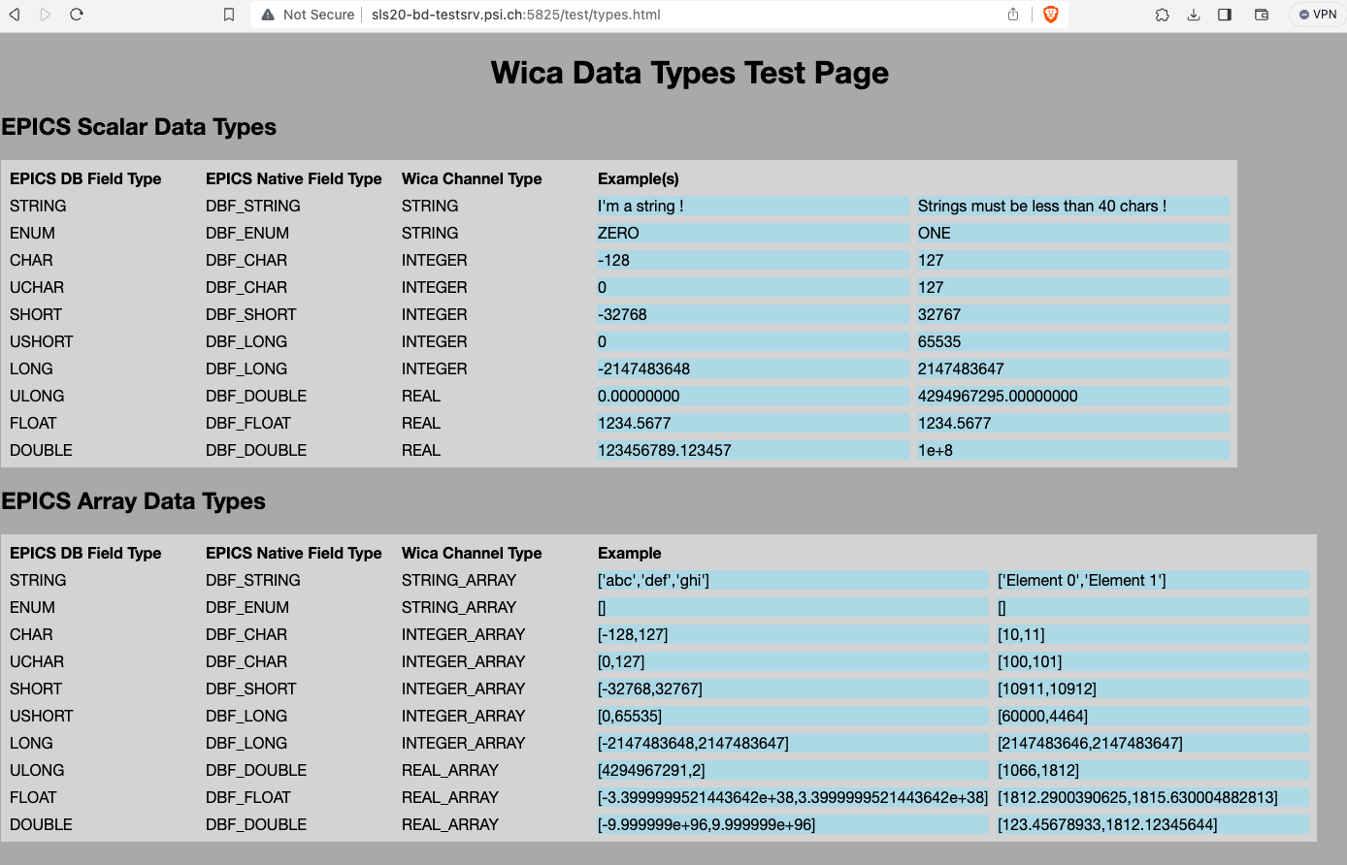
Exercise 3: I will run the EPICS ‘types.db’ test database on the local machine. See if your local server instance can connect to it.
⏰ 5 mins
Navigate to the following URL, but swap the port number of your local server for the one below
http://sls20-bd-testsrv.psi.ch:5825/test/types.html

Slide 13
The ‘types.db’ database looks like this
record( stringout, wica:test:scalar:string1 ) {
field( VAL, "I'm a string !" )
}
record( stringout, wica:test:scalar:string2 ) {
field( VAL, "Strings must be less than 40 chars !" )
}
record( bo, wica:test:scalar:enum1 ) {
field( VAL, "0" )
field( ZNAM, "ZERO" )
field( ONAM, "ONE" )
}
record( bo, wica:test:scalar:enum2 ) {
field( VAL, "1" )
field( ZNAM, "ZERO" )
field( ONAM, "ONE" )
}
record( aSub, "wica:test:scalar:integers" ) {
field( FTA, "CHAR" )
field( INPA, "-128" )
field( FTB, "CHAR" )
field( INPB, "127" )
field( FTC, "UCHAR" )
field( INPC, "0" )
field( FTD, "UCHAR" )
field( INPD, "127" )
field( FTE, "SHORT" )
field( INPE, "-32768" )
field( FTF, "SHORT" )
field( INPF, "32767" )
field( FTG, "USHORT" )
field( INPG, "0" )
field( FTH, "USHORT" )
field( INPH, "65535" )
field( FTI, "LONG" )
field( INPI, "-2147483648" )
field( FTJ, "LONG" )
field( INPJ, "2147483647" )
}
record( aSub, "wica:test:scalar:reals" ) {
field( FTA, "ULONG" )
field( INPA, "0" )
etc
…
Provides EPICS channels of all the standard types

Slide 14
The ‘types.html’ web page looks like this
<!doctype html>
<html lang="en">
<head>
<script src="../wica/wica.js" type="module"></script>
</head>
<body>
<table>
…
<tr><td>FLOAT</td><td>DBF_FLOAT</td><td>REAL</td>
<td data-wica-channel-name="wica:test:scalar:reals.C" data-wica-channel-props='{ "prec": 4}' data-wica-rendering-props ='{ "prec": 4}'>NC</td>
<td data-wica-channel-name="wica:test:scalar:reals.D" data-wica-channel-props='{ "prec": 4}' data-wica-rendering-props ='{ "prec": 4}'>NC</td>
</tr>
<tr><td>DOUBLE</td><td>DBF_DOUBLE</td><td>REAL</td>
<td data-wica-channel-name="wica:test:scalar:reals.E" data-wica-channel-props='{ "prec": 12}' data-wica-rendering-props='{ "prec": 6}'>NC</td>
<td data-wica-channel-name="wica:test:scalar:reals.F" data-wica-channel-props='{ "prec": 12}' data-wica-rendering-props='{ "exp": true }'>NC</td>
</tr>
</table>
<script>
<!-— add JS “intelligence” to your web page here -->
</script>
</body>
</html>
data-wica-channel-props
Define the properties used for the data transfer from the server
data-wica-rendering-props
Define the properties used for displaying the data on the web page
data-wica-channel-name
Define the EPICS channels you want to display

Slide 15
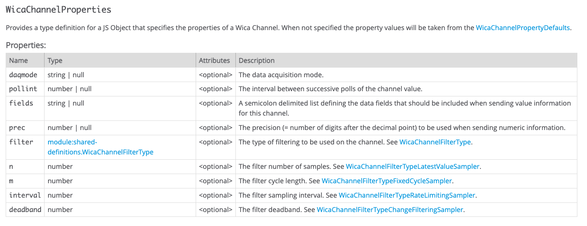
Controlling data acquisition: ‘data-wica-channel-props’
Supports configuration of data transfer options
Poll or monitor channels
Data transfer precision
channel filtering (eg noise or rate limiting)

Slide 16
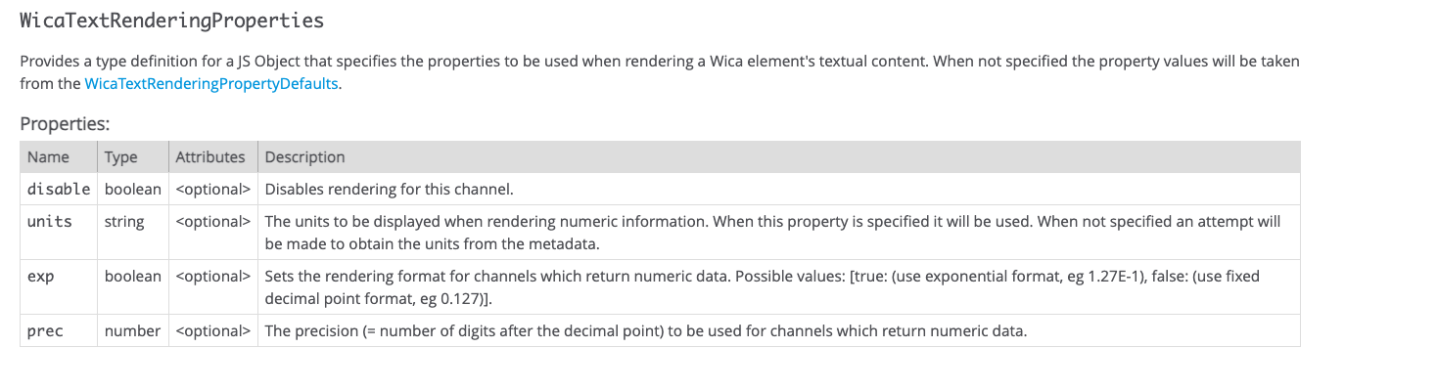
Controlling text rendering: ‘data-wica-rendering-props’
Supports configuration of how the text is displayed
precision
display engineering units
exponential format

Slide 17
Exercise 4: Explore the operations available on the Wica-Http Server
⏰ 5 mins
Follow the instructions at the following URL:
https://github.com/paulscherrerinstitute/wica-http/blob/master/docs/hla/ex4.md
Use curl to get or set some EPICS channel values
Use curl to create and subscribe to a Wica stream

Slide 18
Exercise 5: Read channel values from PSI science facilities
⏰ 5 mins
Navigate a web browser to some of the URL’s below:
PROSCAN - https://gfa-wica.psi.ch/ca/channel/XPROSCAN:TIME:2
HIPA - https://gfa-wica.psi.ch/ca/channel/XHIPA:TIME
SwissFEL - https://gfa-wica.psi.ch/ca/channel/SARUN:FELPHOTENE
Try your own channels…

Slide 19
Exercise 6: A quick look at PSI’s WICA main website
⏰ 5 mins
Navigate a web browser here:
Internal - https://gfa-wica.psi.ch
External - https://wica.psi.ch
And look around at some of the pages.

Slide 20
Some example pages…

Slide 21
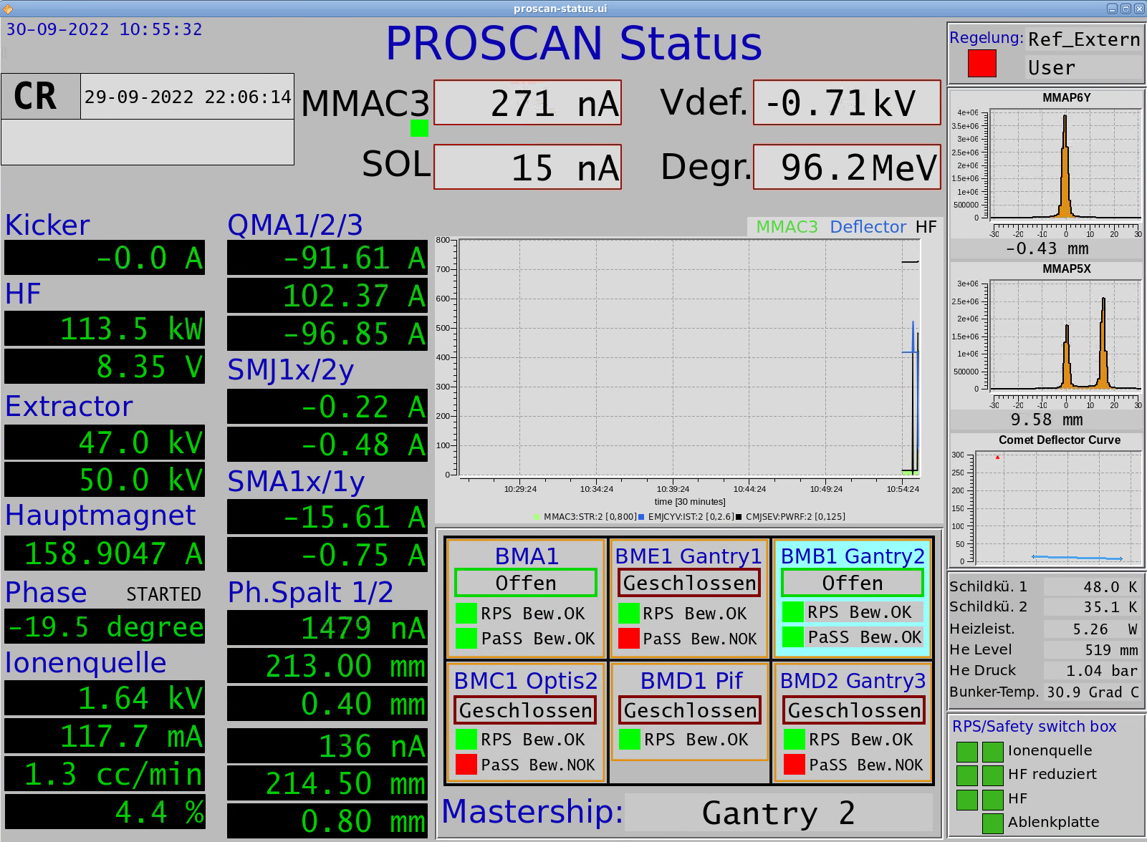
PROSCAN caQtdm Status Page – the gold standard to try to copy
The original display page made with caQtDm
Ugly, but used effectively by many people !
Goal: make something just as ugly, but available on the web

Slide 22
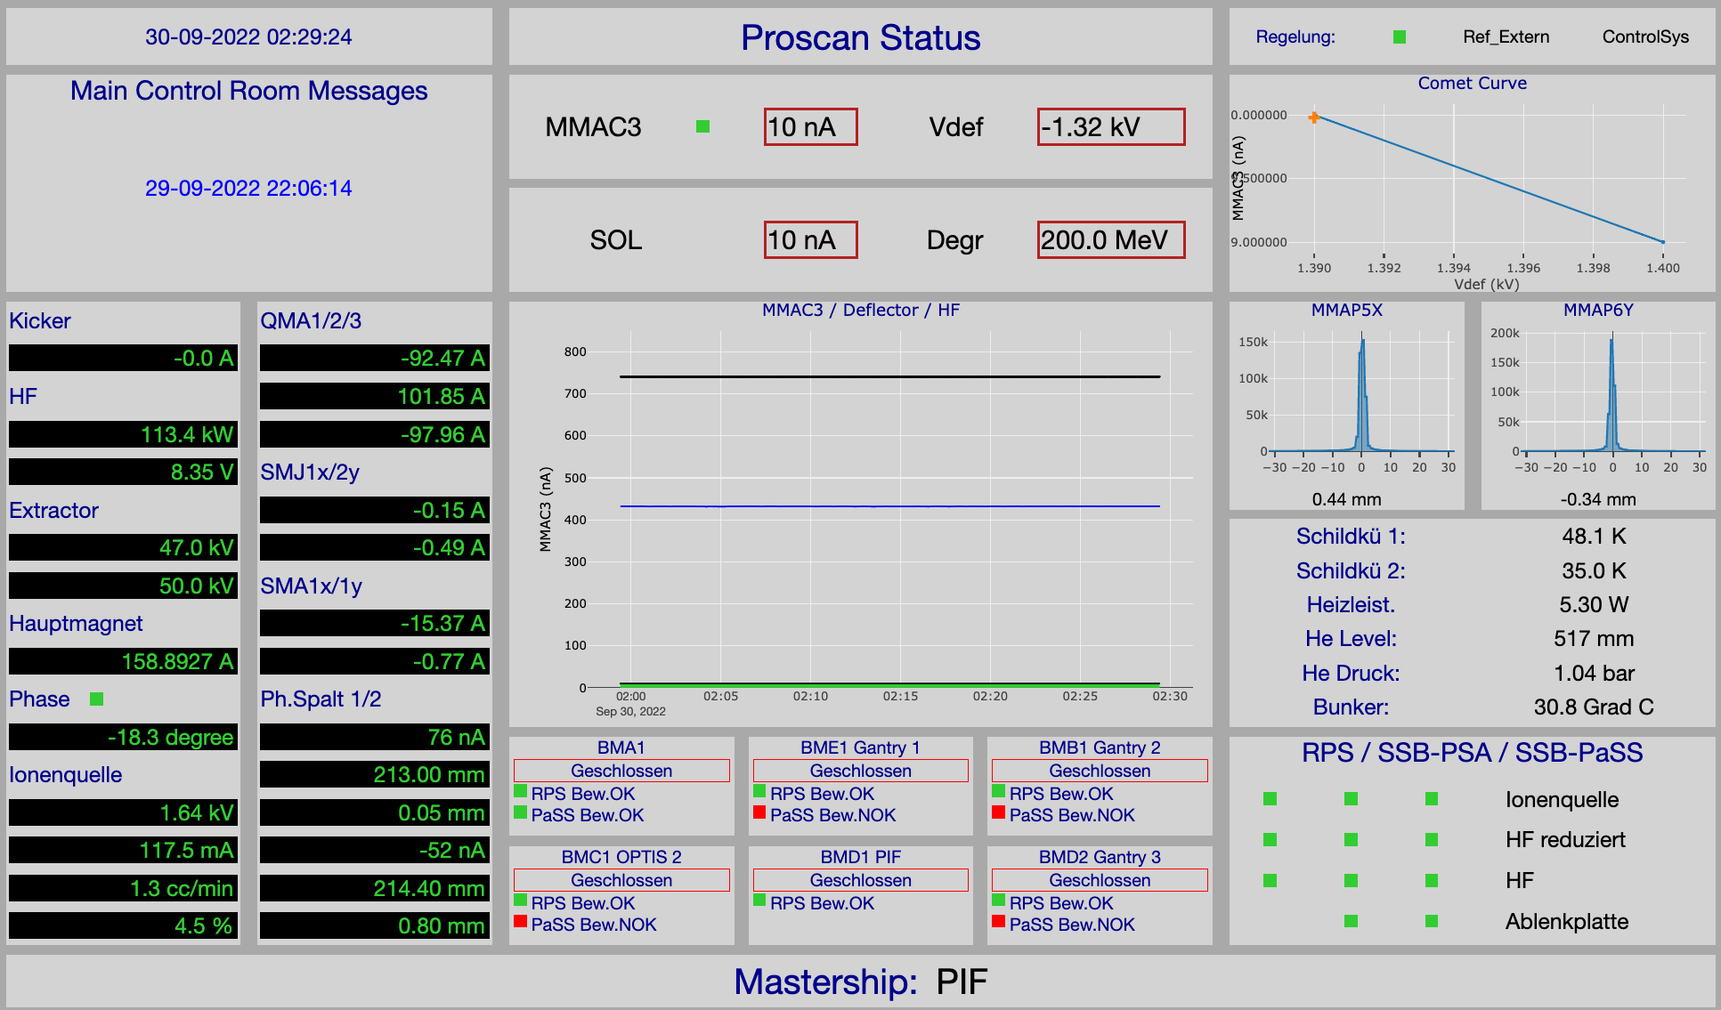

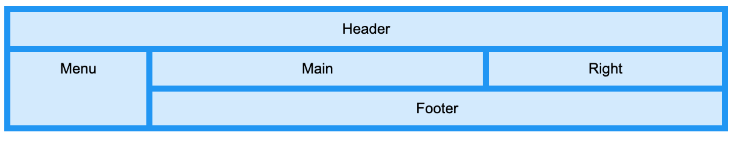
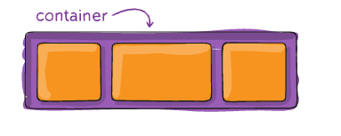
PROSCAN Status Page – Mixed Text & Plot Example
CSS3 Grid
CSS3 Flexbox

Slide 23
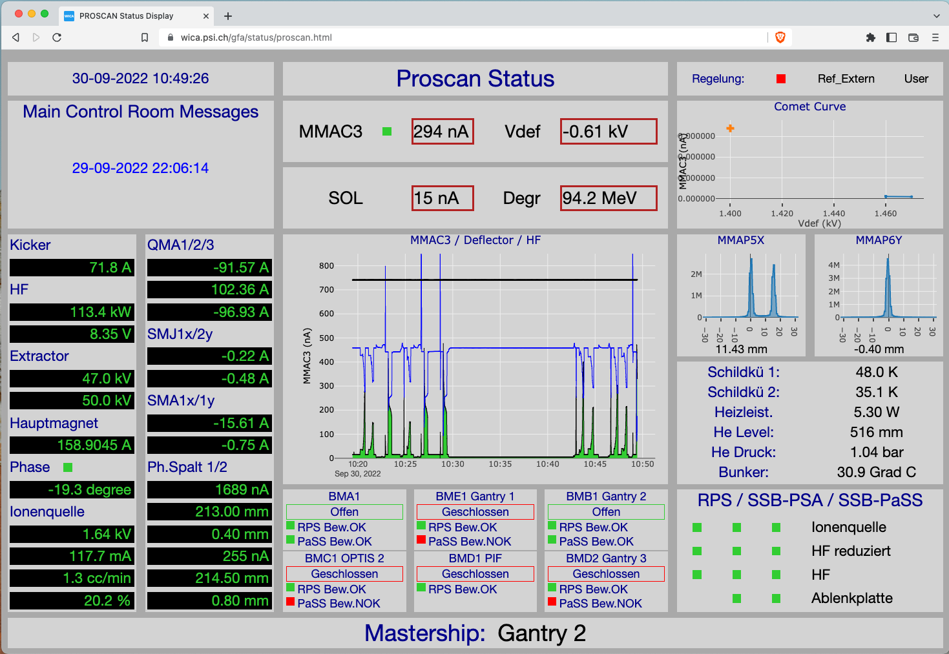
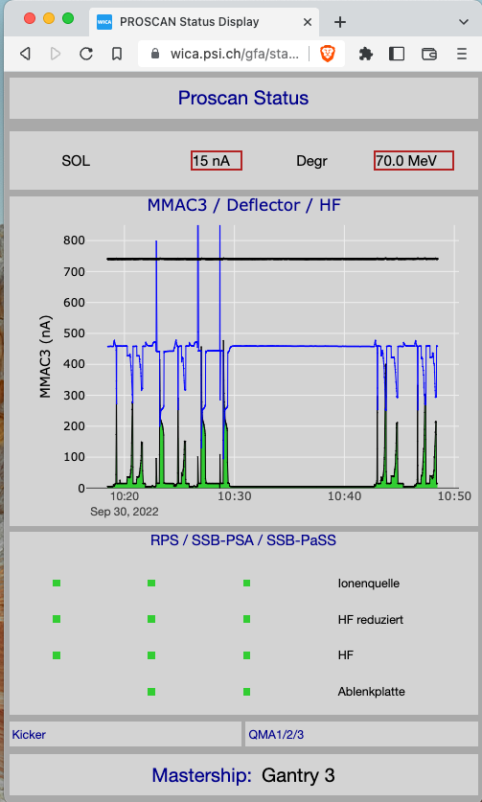
PROSCAN Status Page – responsive design
Because the pages just use normal web technology, we can use CSS media queries to change the formats according to the features of the viewing device…

Slide 24

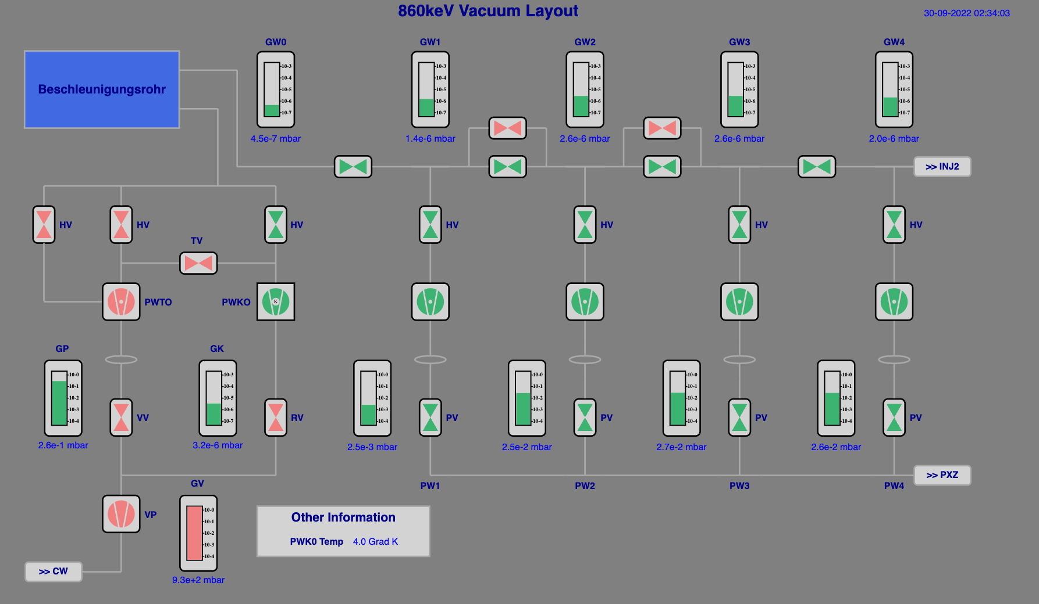

HIPA Vacuum System Page – SVG Example

Slide 25
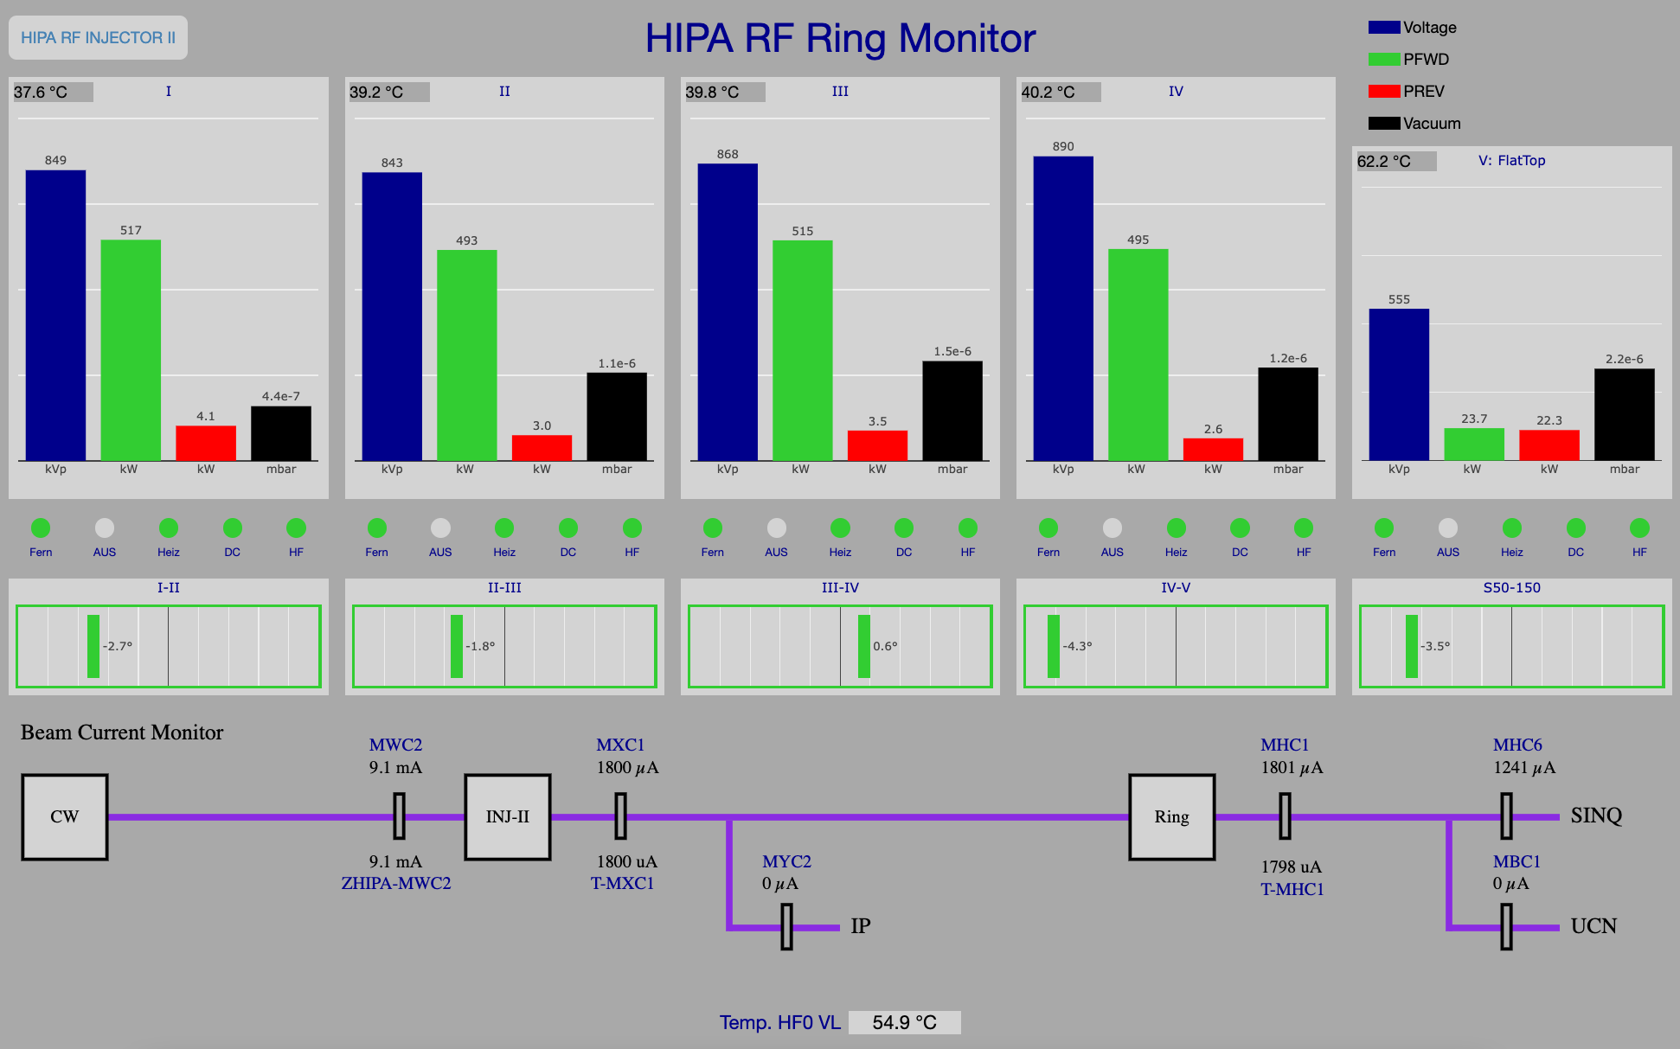
HIPA RF System Page – SVG + Plot Example

Slide 26
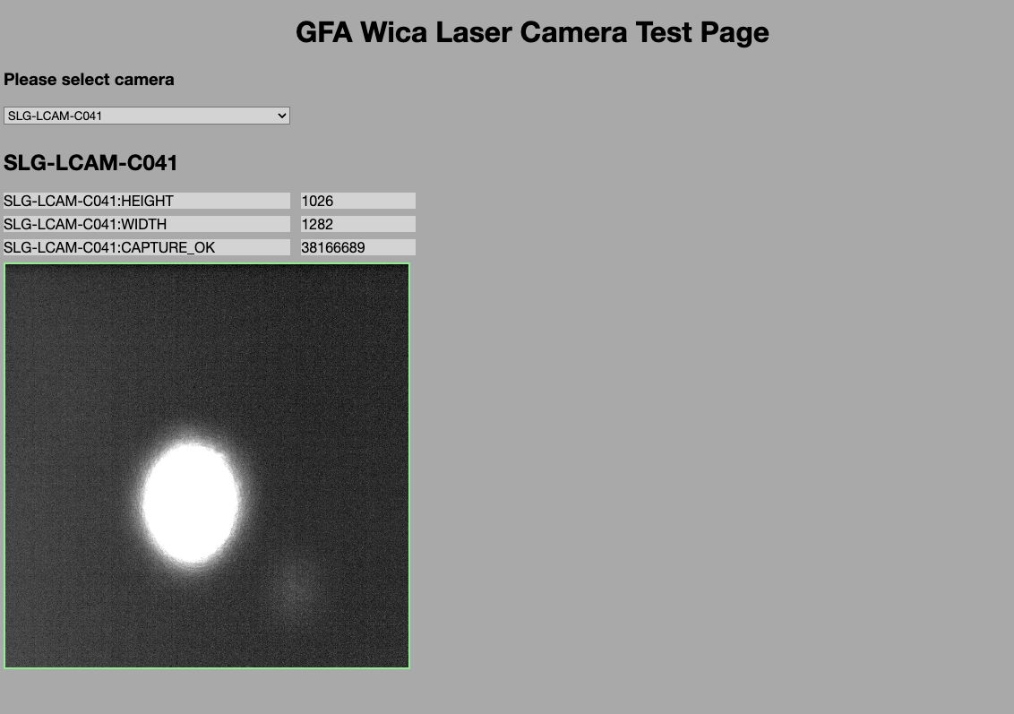

SwissFEL Camera Page – Web Component Example
Using Web Components enable us to create very clean html pages
<gfa-laser-camera-basic imageWidth="300" imageHeight="300" epicsDataChannel="SLG-LCAM-C081:FPICTURE"></gfa-laser-camera-basic>
But creating a web component control system library would require significant effort

Slide 27

Leveraging WICA – possible workflows
Text-only Display Page
Display Page with Text and Plots
Display Page with Text and SVG
Display Page with eg Camera Images
Write some html to define your control points
Write some html to define your control points
Write some html to define your control points
Obtain a Web Component that supports rendering camera image data. At PSI we use Lit
Use an SVG Editor eg Boxy-SVG to create your graphic. Or create graphic with text editor
WICA will render the text content of your elements directly - no JS required.
Choose a JS plot library eg Plotly or Highcharts
Write some html to define the control points associated with each web component
Write some JS to update the plot using the received data
Write some JS to update the graphic using the received data

Slide 28



WICA Learning Experiences so far – a partial success ?
WICA is the only display tool that works off-site ☺
Getting the data to the user’s webpage is easy ☺
It’s also easy to make a webpage with text channels that you can look at offsite. ☺
Currently to make sophisticated webpages with plots, fancy graphics or camera images takes some programming effort. ☹
Providing a tool or workflow for the users (who are not programmers) has been difficult ☹
caqtdm is not under threat ! ☺
BYOI
“Bring your own intelligence”
Web Browser
Web Page
Intelligence
Wica-JS
REST API
Wica-HTTP EPICS Gateway
ca
EPICS IOCs
Sensors
Actuators

Slide 29
Thank you for your attention :-)
If you have questions, or would like to find out more, please get in touch.

